Slide 1
Importance Of Effective Leadership
Facilitator’s Training Seminar
Session- 2

Slide 2
The Importance Of Effective leadership
OVERVIEW
This session explains the importance of effective leadership. It points out the necessity of leaders and believers working together as a team. Through effective leadership, the church is mobilized to accomplish the will and purpose of God for the church. It is important for leaders to recognize danger signs of ineffective leadership and major reasons why churches fail to grow.
Time required to complete this session: 1 1/2 hours

Slide 3
The Importance Of Effective leadership
GOALS OF THE SESSION
1. Understand the roles of a leader and a believer
2. Learn danger signs of bad leadership
3. Learn how to mobilize the church
4. Maturity is shown through active believers
DISCOVERY SESSION AT END

Slide 4
The Importance Of Effective leadership
Mobilization of the Church
Roles of Service (Eph 4:11-16)
Encouraging
Teaching
Prophecy
For
Works of
Service
(Rom 12:6-8)
– Apostles
– Prophets
– Evangelists
– Pastors
– Teachers
To
Prepare
God’s
People
Mercy
Leading
Serving
Note: Additional “works of service” are given in 1 Corinthians 12.
Giving
Contribution
Diagram 2:1

Slide 5
The Importance Of Effective leadership
Effective Preparation produces the Following RESULTS:
God’s people are prepared (equipped) to do works of service for one another and others.
The Church (body of Christ) is built up.
Believers reach unity in their faith and knowledge of God and His son, Jesus Christ.
Believers mature in their faith and Christian walk.

Slide 6
The Importance Of Effective leadership
Key To Church Growth :
Equipping Believers For Ministry And Works Of Service.

Slide 7
The Importance Of Effective leadership
Why do Local Churches Fail To Grow?

Slide 8
The Importance Of Effective leadership
Who is doing ALL of the work?
Why are most of the oars not being used?
Are the people in the boat working? Or playing?
Are the purposes of God being fulfilled in this boat (Church)?
Do you think the boat (Church) is making much progress?
Diagram 2:2
A Pastor-Dependent Church

Slide 9
The Importance Of Effective leadership
Table 2.1 Danger Signs of Ineffective Leadership
Believer’s Attitude | Cause Of Problem
Believers do not like where they are or how they got there. | Leaders may have failed to communicate the vision effectively.
 | Believers may not be sure about their role in the church
Believers are apathetic, uncommitted and undecided. | Leaders may have failed to teach God’s Word effectively.
 | Believers may not be reading the Word and seeking to follow God’s direction in their lives.
Believers do not know what to do, how to do it, or why a task should be done. | Leaders may have failed to teach and communicate effectively.
 | Believers may not be listening or obeying their leaders or the Holy Spirit.
There is no system or order for accomplishment. | Leaders failed to put into work an effective plan
 | Believers may have been unwilling to participate in previous church activities and programs

Slide 10
The Importance Of Effective leadership
Mobilize Every Believer to Pray
Diagram 2:4

Slide 11
The Importance Of Effective leadership
Mobilize every believer to witness, win and disciple
Witness
Win
Disciple
Diagram 2:5

Slide 12
The Importance Of Effective leadership
Evangelism – The task of the whole church
X
Diagram 2:6

Slide 13
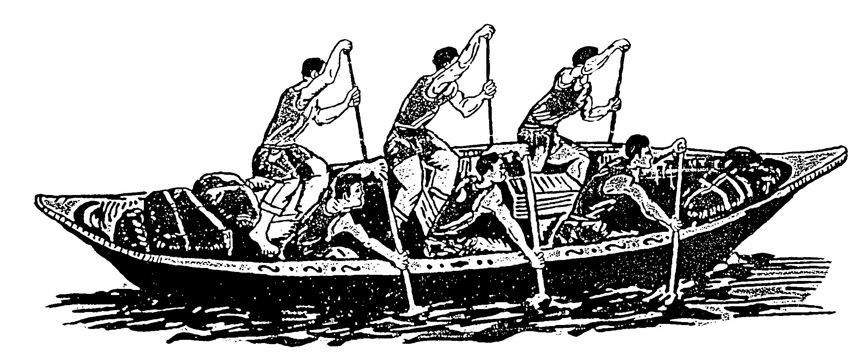
The Importance Of Effective leadership
A Mobilized Church
Diagram 2:7

Slide 14
The Importance Of Effective leadership
Discovery Session

Slide 15
The Importance Of Effective leadership
DISCOVERY SESSION
Break into small groups of 5-7 people and discuss the following:
The following hindrances are provided when working through activity #2.
Discrimination (Acts 6:1-2)
Division (acts 15:1-5)
Disputes over “sheep” (1Corinthians 1:10-13)
Food sacrificed to idols (1 Corinthians 8:1-13)
Neglect of need (Acts 6:1-2)
Sin and forgiveness – stumbling blocks (Luke 7:1-4)
Lawsuits among believers (1 Corinthians 5:1-8)

Slide 16
The Importance Of Effective leadership
DISCOVERY SESSION
Break into small groups of 5-7 people and discuss the following:
The following hindrances are provided when working through activity #2.
Discrimination (Acts 6:1-2)
Division (acts 15:1-5)
Disputes over “sheep” (1Corinthians 1:10-13)
Food sacrificed to idols (1 Corinthians 8:1-13)
Neglect of need (Acts 6:1-2)
Sin and forgiveness – stumbling blocks (Luke 7:1-4)
Lawsuits among believers (1 Corinthians 5:1-8)

Slide 17
The Importance Of Effective leadership
DISCOVERY SESSION
1.Talk about the things that help a church grow. List them in order of priority. Limit your list to 10-15 things that create or improve church growth.
2.In the same discussion groups, do the following activity.
>List some people in the Bible who faced these same problems. See the list of “Hindrances to church growth.”
>Pick 2 or 3 of these people to discuss in more detail.
List the spiritual obstacles they encountered.
>Discuss how they solved their problems.

Slide 18
Importance of effective Leadership
Contact: Info@Equippersgroup.org

